Slide 1



Welcome to Telerik Software Academy
Spring Group – April 2013
Svetlin Nakov
Manager Technical Training
www.nakov.com
Telerik Software Academy
academy.telerik.com

Slide 2



Table of Contents
About Telerik
About the Software Academy
"Software Academy" Training Program
Requirements for All Trainees
Telerik Academy

Slide 3
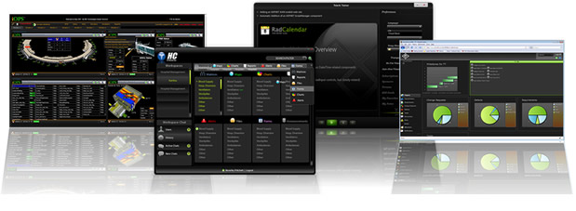


About Telerik
What Makes Telerik so Successful?

Slide 4

About Telerik
What does Telerik do?
Software development productivity tools
ASP.NET AJAX and MVC, Silverlight, WPF, WP7, Win8 and HTML5 components, ORM, Reporting, CMS Solutions, Productivity Tools, Testing Tools, Agile PM Tools, Mobile Dev Tools
Headquartered in Bulgaria
With offices in USA, Germany, Australia, India
750 employees – mostly developers
Employer #1 in Bulgaria for 2012

Slide 5

Why Telerik is Successful?
Hard Work
Essential to the success of any company
Good People
The greatest capital of the company
Constant Improvement
Adaptive to changes
Open Communication
Everyday we get feedback and improve our products and work processes

Slide 6
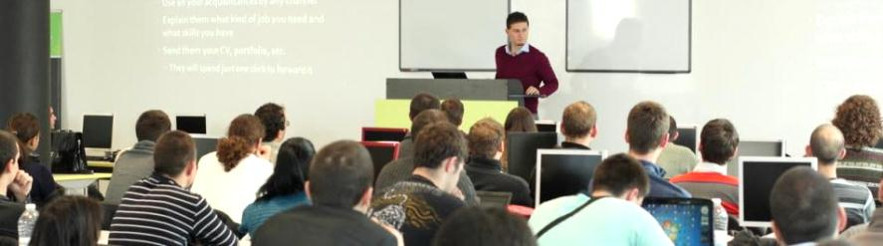

Telerik Academy
Free Trainings for Software Engineers

Slide 7
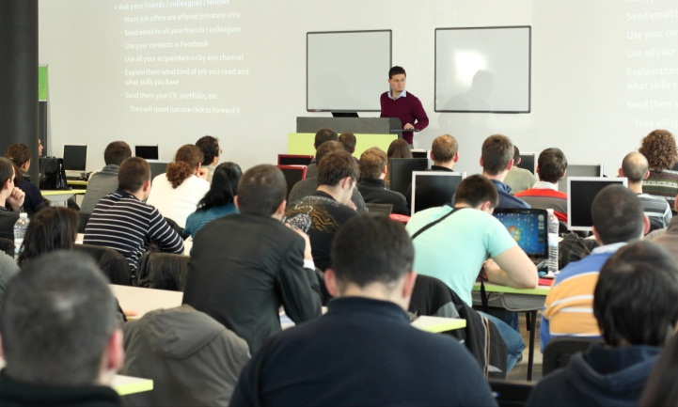
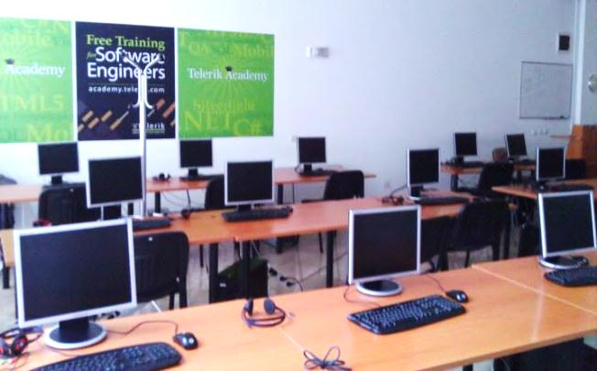

About Telerik Academy
Telerik Academy is an initiative for free training young software engineers
Software Academy: .NET Devs, Web & XAML Front-Ends, QAs, Dev-Supports
Kids Academy
School Academy
Algo Academy
Online Courses
Contests and free initiatives

Slide 8
Learning Tracks
Kids Academy
Online Courses
School Academy
Algo Academy
Software Academy
Programming
HTML & JS
Team Work
Soft Skills
XAML Dev.
Web Dev.
JS Dev.
QA
Dev. Support
Job at Telerik
Another Job

Slide 9





"Software Academy" Program
What is It? How It Works? The Learning Tracks

Slide 10
The “Software Academy” Program @ Telerik
Become a skillful software engineer for free
It takes 12-16 months (half → full time job)
Learning, homework, projects, team work
Web development track (HTML5, JavaScript, …)
Programming track (C#, OOP, DB, …)
Professional tracks
ASP.NET Web Developer, XAML Developer, QA, Support Engineer, Web Front-End, Mobile Dev, Windows 8 Dev, Cloud Dev, System Admin, …

Slide 11
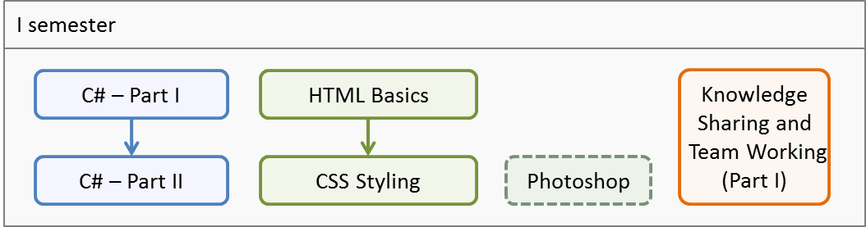
Software Academy: First Semester
C# programming and Web technologies basics
Spring group (Apr 2013 – Jan 2014) – 600 students
1 time weekly, 3 hours in class + homework
Autumn group (Sep 2013 – Jan 2014) – 1000 studs.
3-4 times weekly, 4 hours in class + homework
3 team work projects

Slide 12
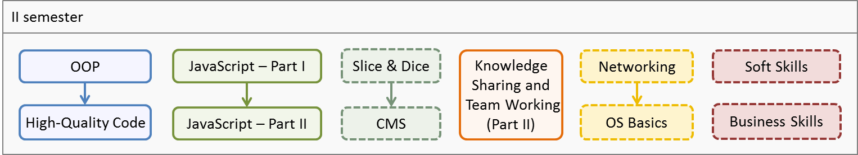
Software Academy: Second Semester
Advanced C# programming and JavaScript
Elective courses: front-end + admin + soft skills
Jan 2014 – May 2014 (900 students)
3 times weekly, 4 hours in class + homework
3 team work projects

Slide 13
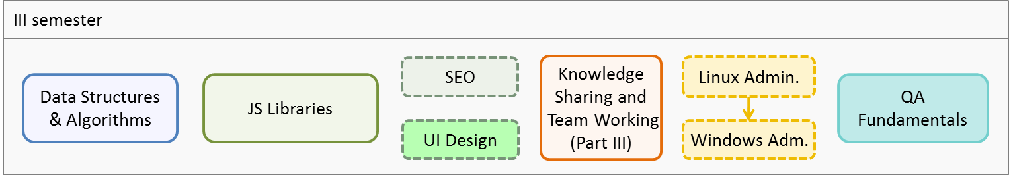
Software Academy: Third Semester
DS & Algorithms and JS Libraries
Elective courses: SEO, UI Design, System Admin
QA Academy start
May 2014 – June 2014 (600 students)
3 times weekly, 4 hours in class + homework
2 team work projects

Slide 14
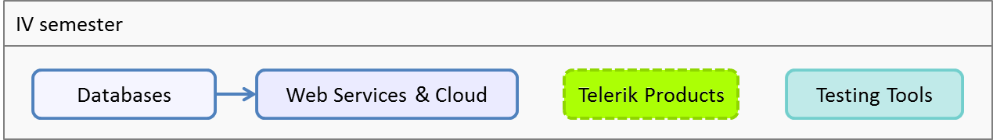
Software Academy: Fourth Semester
Databases and SQL
Web services & cloud development
Telerik products and tools
July 2014 (300 students)
Full time (5 times weekly, 8 hours in class)
1 team work project

Slide 15
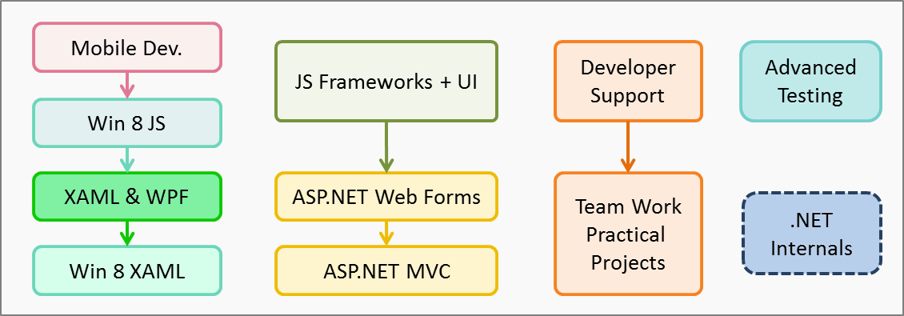
Software Academy: Fifth Semester
Professional tracks
August 2014 – September 2014 (300 students)
Full time (5 times weekly, 8 hours in class)
3 team work projects

Slide 16
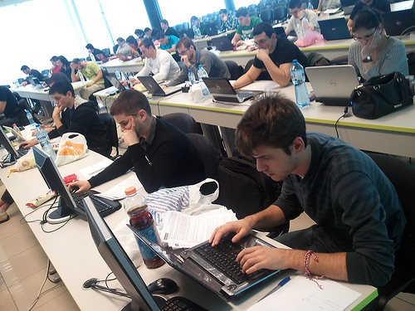

Requirements for All Trainees
The Training Program Requires 100% Commitment!

Slide 17

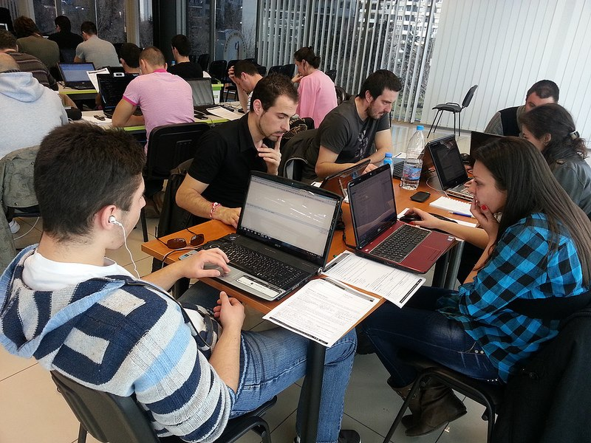
Requirements for All Trainees
Basic computer skills
We don’t teach computer literacy
English
Ability to read technical documentation in English is enough
Very serious attitude
Long-term commitment
8 hours / day (average)

Slide 18

Full Commitment
Key factors for succeeding in the Software Academy Training Program
Solid motivation & attitude
Willingness for very hard work!
“Cheaters” are not welcome
All your time
50% in class (for the lectures and exercises)
50%-500% at home (for the homework)
All your energy for knowledge sharing

Slide 19

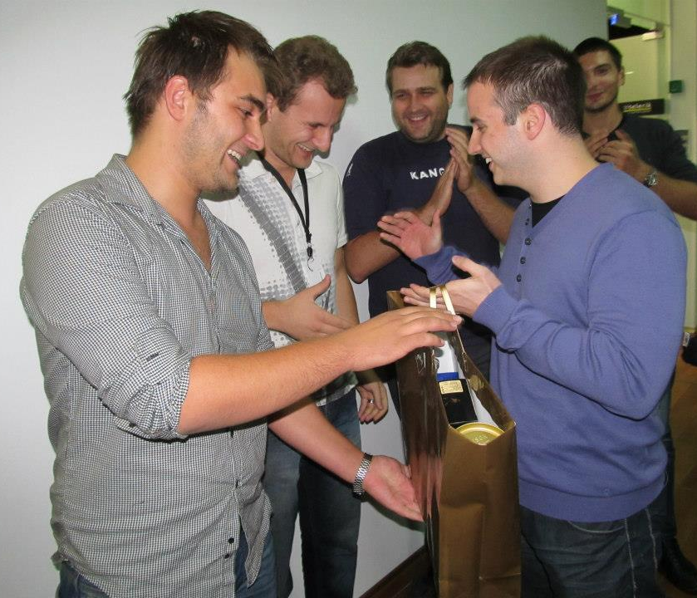
Invest in Yourself!
Invest in yourself!
Invest in your training!
Invest in your skills development!
… Unless you consider yourself a bad investment. Do you?

Slide 20
Welcome to Telerik Software Academy
http://academy.telerik.com

Slide 21


Free Trainings @ Telerik Academy
Fundamentals of C# Programming Track of Courses
csharpfundamentals.telerik.com
Telerik Software Academy
academy.telerik.com
Telerik Academy @ Facebook
facebook.com/TelerikAcademy
Telerik Software Academy Forums
forums.academy.telerik.com

